Slide 1
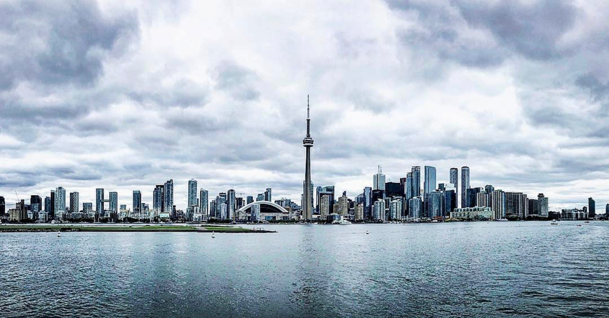
Battle Of Neighbourhood
- Manik Garg

Slide 2
Introduction
There are many cities with many differences.
We are trying to Predict dissimilarity of Toronto and New York
Reference used is of Coffee Shop Neighborhood.

Slide 3
Data Used
New York data is from https://cocl.us/new_york_dataset
Toronto data is from the week 3 analysis. City based data is from https://en.wikipedia.org/wiki/List_of_postal_codes_of_Canada:_M
The Find Latitude and Longitude site (https://www.findlatitudeandlongitude.com/) has used to get the boundary of these cities and make sure we are not out of metropolitan area and used http://cocl.us/Geospatial_data
Foursquare API service has used to get the required data for the report.
In total, 288 rows in the raw dataset. Cleaned data has 103 rows.

Slide 4
Methodology
Used GitHub repository
Folium library for Maps
K Means Clustering for segmentation
Foursquare API for location data

Slide 5
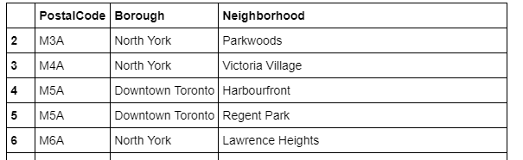
Screenshot of Initial Toronto Data

Slide 6
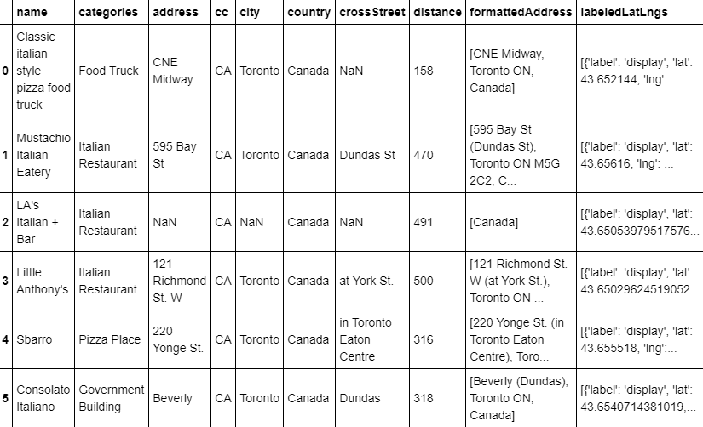
Toronto Coffee Data

Slide 7
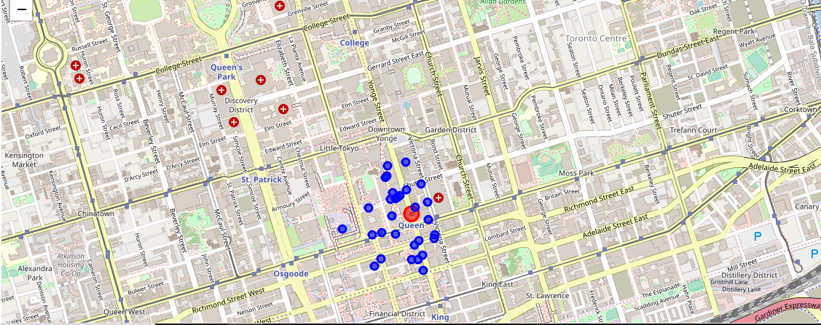
Toronto Coffee Data

Slide 8
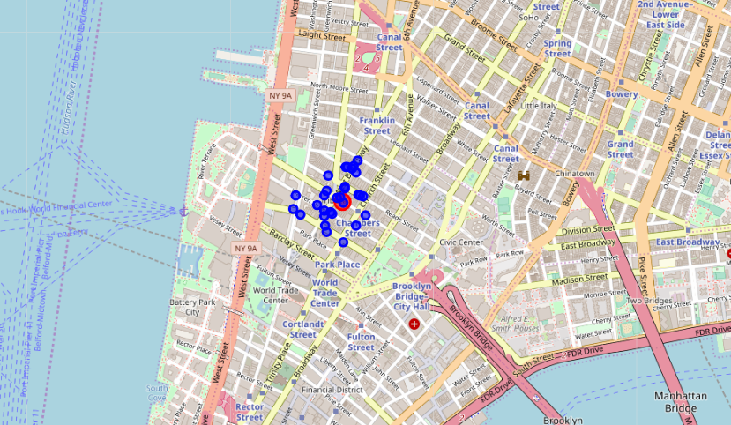
New York Coffee Data

Slide 9
Discussion
Used the Means algorithm as part of this clustering study with optimum k value to 3
I also performed data analysis through this information by adding the coordinates of districts and location of various food joints as static data on GitHub.

Slide 10
Conclusion
As a result, people are turning to big cities to start a business or work. For this reason, people can achieve better outcomes through their access to the platforms where such information is provided.
Anyone who wish to open a food joint or mainly coffee shop near building like government building can use the analysis.

